Slide 1

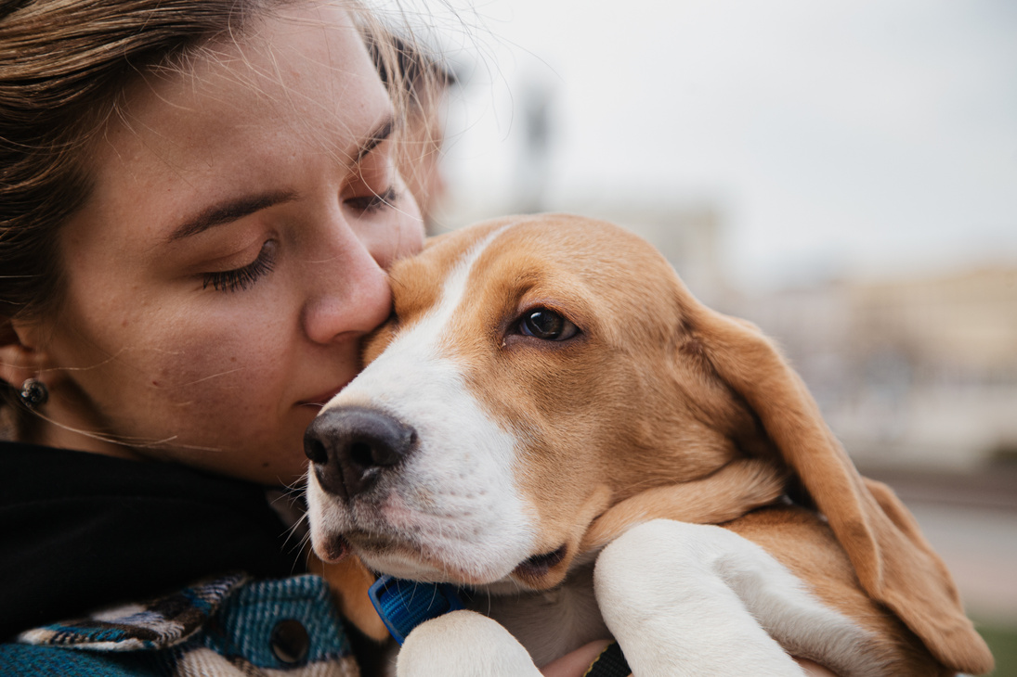
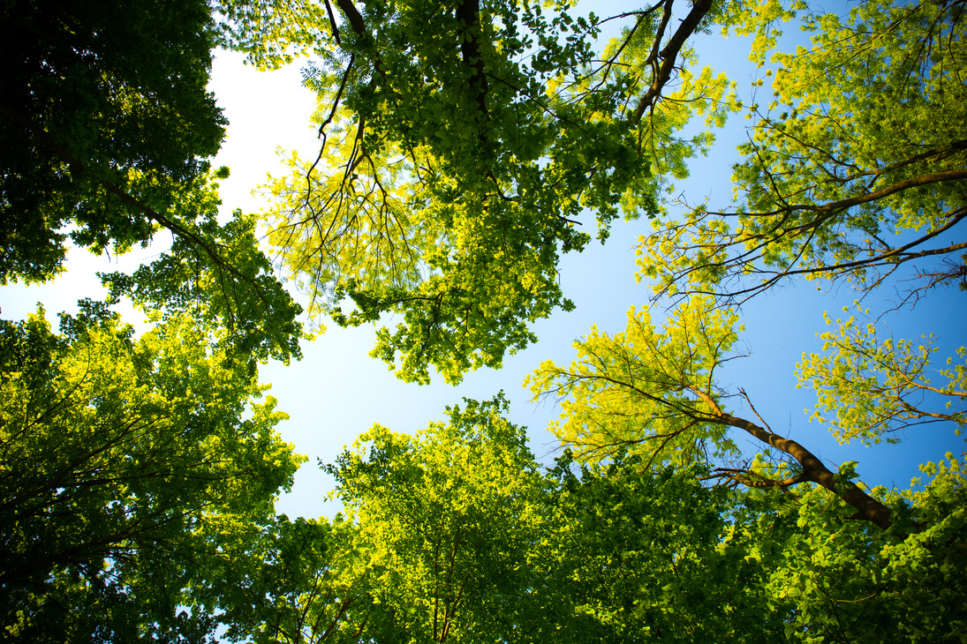

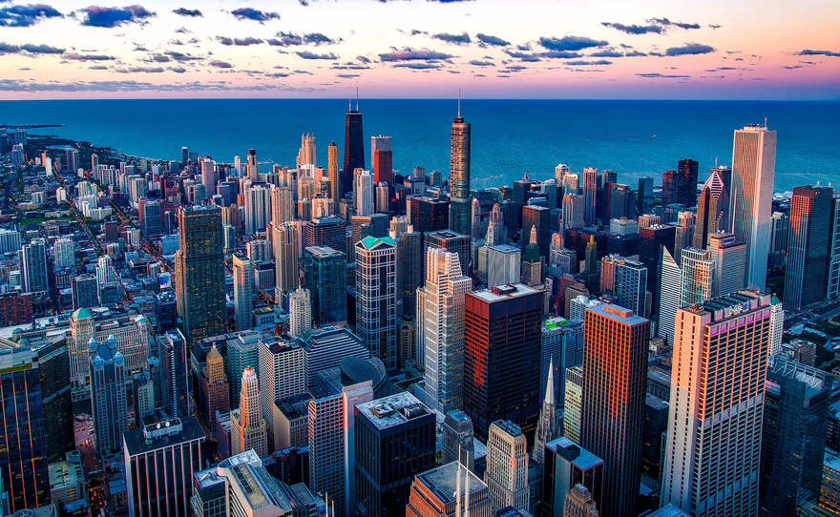
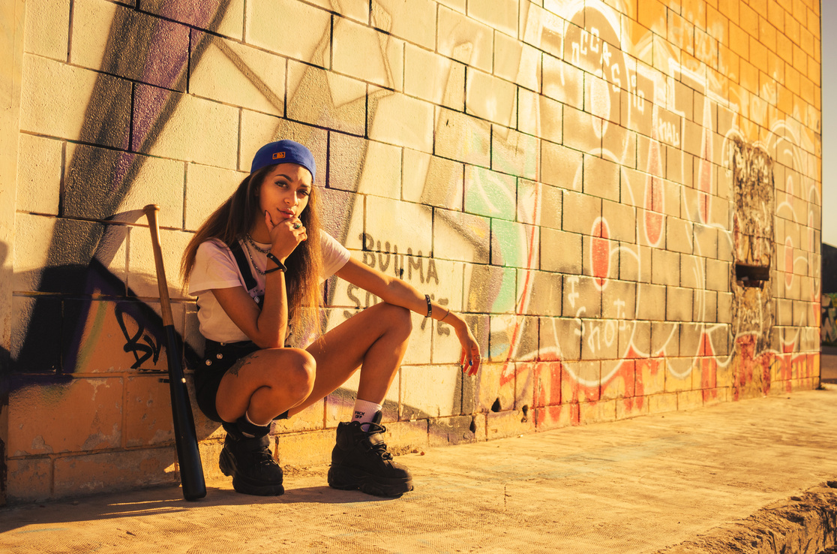


MINI PROJECT PRESENTATION
IMAGE FORGERY DETECTION WITH CNNS
PRESENTED BY:
AJISH S
NM ID:au963321104002
BE CSE
ajish24ajish@gmail.com

Slide 2


PROJECT TITLE
IMAGE FORGERY DETECTION WITH CNNS
“NAAN MUDHALVAN - MACHINE LEARNING TO GENERATIVE AI”

Slide 3
AGENDA
Problem Statement
Project Overview
Who Are The End Users?
Proposed Solution
Solution and its value proposition
System Development Approach
Modelling
Result
Conclusion

Slide 4
PROBLEM STATEMENT
Despite the advancement of CNN architectures in detecting image forgeries with high accuracy, the effectiveness of these models on more challenging samples remains unclear. This raises the question of how well CNNs perform when faced with difficult-to-detect forgeries. In this study, we aim to address this question by developing a CNN network inspired by previous research and evaluating its performance on two distinct datasets. Additionally, we investigate the impact of data augmentation techniques and various hyperparameters on classification performance. Our experiments reveal that the difficulty level of the dataset significantly influences the obtained detection performance, highlighting the need for robust forgery detection methods.

Slide 5
PROBLEM OVERVIEW
Introduction:
The proliferation of digital images and the accessibility of image editing software have facilitated image tampering, leading to various issues like misinformation and fraud. Detecting such forgeries is crucial for maintaining trust and integrity in digital media. In this project, we aim to develop a robust image forgery detection system using Convolutional Neural Networks (CNNs), which have shown promise in automating this task.
Objectives:
Develop a CNN-based image forgery detection model capable of accurately identifying manipulated images.
Evaluate the performance of the CNN model on challenging forgery cases that are difficult for humans to detect.
Investigate the impact of different CNN architectures, data augmentation techniques, and hyperparameters on the detection performance.
Compare the effectiveness of the CNN model across multiple datasets with varying degrees of difficulty.
Implement the forgery detection system to operate efficiently in real-time or with minimal latency.

Slide 6
WHO ARE THE END USERS?
Law enforcement agencies: Police departments, intelligence agencies, and other law enforcement bodies may use image forgery detection systems to investigate crimes involving digital manipulation of images, such as forged documents, tampered evidence, or manipulated surveillance footage.
Forensic experts: Forensic analysts and experts may use CNN-based image forgery detection tools to authenticate digital images submitted as evidence in legal proceedings, ensuring their integrity and reliability.
1.
2
Media organizations: News agencies, publishing houses, and online platforms may employ image forgery detection techniques to verify the authenticity of images before publishing or sharing them with the public, thus maintaining credibility and trustworthiness.
Social media platforms: Companies operating social media platforms may integrate image forgery detection algorithms into their systems to detect and prevent the spread of fake or manipulated images, thereby combating misinformation and preserving the integrity of their platforms.
3
4

Slide 7
WHO ARE THE END USERS?
Digital content creators: Professionals working in fields such as photography, graphic design, and digital art may utilize image forgery detection tools to protect their intellectual property rights and prevent unauthorized alterations or misuse of their work.
Academic researchers: Researchers studying digital forensics, computer vision, and image processing may develop and utilize CNN-based image forgery detection techniques for academic purposes, such as advancing the state-of-the-art in the field or conducting experiments to understand the effectiveness and limitations of different detection methods.
5
6

Slide 8
PROPOSED SOLUTION
Develop a Convolutional Neural Network (CNN) network inspired by previous studies: The project aims to build upon existing CNN architectures proposed for image forgery detection. This involves designing a neural network model that can effectively identify tampered or manipulated images.
Evaluate CNN performance on challenging samples: The project seeks to assess the effectiveness of CNN-based image forgery detection on more challenging samples. This involves testing the developed CNN network on datasets containing images that are not easily recognized by humans, thus simulating real-world scenarios where sophisticated image manipulations are involved.
Compare performance on two separate datasets: The project involves conducting experiments on two distinct datasets to gauge the robustness and generalization ability of the CNN network. By comparing performance across different datasets, the study aims to provide insights into the network's performance under varying conditions and image characteristics.
Measure the effect of data augmentation and hyperparameters: The project investigates the impact of data augmentation techniques and different hyperparameters on the classification performance of the CNN network. This involves exploring how modifications to training data and network configurations influence the network's ability to accurately detect image forgeries.
Analyze experimental results: Through rigorous experimentation and analysis, the project aims to elucidate the relationship between dataset difficulty, data augmentation, hyperparameters, and CNN performance. Insights gained from the experiments can help in understanding the factors that contribute to the success or limitations of CNN-based image forgery detection systems.

Slide 9
SOLUTION AND ITS PROPOSITION
Effective Detection of Image Forgeries: By leveraging deep learning techniques, particularly CNNs, the solution aims to accurately identify tampered or manipulated images. This provides value by enhancing the ability to detect fraudulent or misleading content in digital images, which is crucial for various applications such as forensic analysis, media verification, and content moderation on social media platforms.
Robust Performance on Challenging Samples: The solution addresses the need for robustness in image forgery detection by evaluating CNN performance on more challenging samples. By testing the network on datasets containing sophisticated manipulations that are not easily recognizable by humans, the solution provides insights into the network's ability to handle real-world scenarios where image tampering techniques are advanced.
Comparative Analysis Across Datasets: Conducting experiments on two separate datasets enables a comparative analysis of the CNN's performance under varying conditions and image characteristics. This allows for a deeper understanding of how dataset difficulty influences detection accuracy, thereby informing the selection of appropriate datasets for training and testing image forgery detection systems.
.

Slide 10
SOLUTION AND ITS PROPOSITION
4. Optimization through Data Augmentation and Hyperparameters: The solution explores the impact of data augmentation techniques and different hyperparameters on CNN performance. By identifying optimal data augmentation strategies and network configurations, the solution enhances the classification performance of the CNN, leading to more reliable and accurate detection of image forgeries.
5. Insights for Improved Detection Systems: Through rigorous experimentation and analysis, the solution generates insights into the factors that contribute to the success or limitations of CNN-based image forgery detection systems. These insights can inform the development of improved detection algorithms, training methodologies, and deployment strategies, ultimately advancing the state-of-the-art in image forensics and enhancing the trustworthiness of digital content.

Slide 11
SYSTEM DEVELOPMENT APPROACH
Problem Definition and Requirements Gathering: Begin by clearly defining the problem of image forgery detection and identifying the specific requirements and objectives of the system. Determine the types of image manipulations to be detected, the desired level of accuracy, and any constraints or limitations on the system.
Data Collection and Preprocessing: Gather a diverse dataset of digital images containing both authentic and manipulated samples. Ensure that the dataset covers a wide range of image manipulation techniques and complexities. Preprocess the images as needed, including resizing, normalization, and augmentation to enhance the diversity and quality of the training data.
Model Selection and Architecture Design: Choose an appropriate CNN architecture for image forgery detection, considering factors such as model complexity, computational efficiency, and performance. Design the architecture of the CNN, including the number of layers, filter sizes, activation functions, and regularization techniques.

Slide 12
SYSTEM DEVELOPMENT APPROACH
4.Training and Validation: Split the dataset into training, validation, and test sets. Train the CNN model using the training data, optimizing the model parameters to minimize the loss function. Validate the model's performance using the validation set, monitoring metrics such as accuracy, precision, recall, and F1 score to assess its effectiveness in detecting image forgeries.
5.Hyperparameter Tuning and Optimization: Fine-tune the hyperparameters of the CNN model, including learning rate, batch size, dropout rate, and optimizer settings, to improve performance and convergence speed. Experiment with different configurations to identify the optimal settings for the given dataset and problem domain.
6.Evaluation and Testing: Evaluate the trained CNN model using the test set to assess its generalization performance on unseen data. Measure various performance metrics to quantify the model's accuracy, robustness, and sensitivity to different types of image manipulations. Conduct thorough analysis and interpretation of the results to identify strengths, weaknesses, and areas for improvement.

Slide 13
SYSTEM DEVELOPMENT APPROACH
7.Deployment and Integration: Once the CNN model has been trained and validated, deploy it into production environments where image forgery detection is required. Integrate the model into existing software systems or develop custom applications for end-users to access and utilize the detection capabilities effectively.
8. Monitoring and Maintenance: Continuously monitor the performance of the deployed system, collecting feedback and updating the model as needed to adapt to evolving threats and challenges in image forgery detection. Regularly retrain the model with new data to ensure its effectiveness and reliability over time.

Slide 14
MODELING

Slide 15
CNN Architecture Selection: Choose an appropriate CNN architecture that has shown effectiveness in image classification tasks. Common choices include architectures like VGG, ResNet, Inception, or custom-designed architectures tailored to the specific requirements of image forgery detection
Layer Configuration: Design the architecture of the CNN by specifying the number of layers, the size of convolutional filters, the number of feature maps, and the structure of pooling layers. Experiment with different architectures to find the optimal balance between model complexity and performance.
1
2
Activation Functions: Select appropriate activation functions for the hidden layers of the CNN, such as ReLU (Rectified Linear Unit), Leaky ReLU, or ELU (Exponential Linear Unit), to introduce non-linearity and enable the network to learn complex patterns in the input data.
Regularization Techniques: Incorporate regularization techniques like dropout or batch normalization to prevent overfitting and improve the generalization ability of the CNN model. Regularization helps in reducing the likelihood of the model memorizing the training data and improves its performance on unseen data.
3
4

Slide 16
Loss Function Selection: Choose a suitable loss function for training the CNN, depending on the nature of the image forgery detection task. Common choices include categorical cross-entropy loss for multi-class classification tasks or binary cross-entropy loss for binary classification tasks.
Optimizer Selection: Select an appropriate optimizer algorithm, such as SGD (Stochastic Gradient Descent), Adam, or RMSprop, to update the weights of the CNN during training and minimize the loss function. Experiment with different optimizers and learning rates to find the optimal convergence behavior.
5
6
Hyperparameter Tuning: Fine-tune the hyperparameters of the CNN model, including learning rate, batch size, dropout rate, and optimizer settings, through iterative experimentation and validation on a separate validation dataset. Optimize the hyperparameters to improve the performance and convergence speed of the model.
Data Augmentation: Incorporate data augmentation techniques such as rotation, flipping, scaling, and cropping to artificially increase the diversity of the training dataset and improve the robustness of the CNN model to variations in input images.
7
8

Slide 17
9
Transfer Learning: Optionally, leverage pre-trained CNN models trained on large-scale image datasets like ImageNet and fine-tune them for image forgery detection tasks. Transfer learning can help in overcoming data scarcity and accelerating the training process.
10
Model Evaluation: Evaluate the performance of the trained CNN model using metrics such as accuracy, precision, recall, F1 score, and confusion matrix on a separate test dataset. Analyze the model's performance to assess its effectiveness in detecting image forgeries and identify areas for improvement.

Slide 18
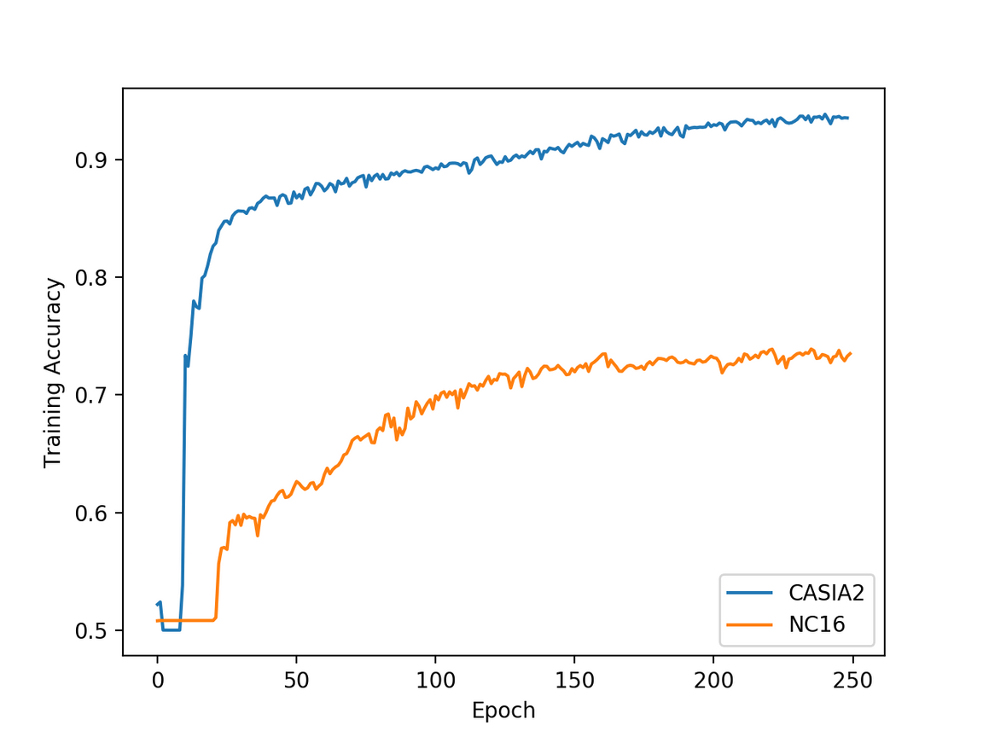
RESULT
DEMO LINK:

Slide 19
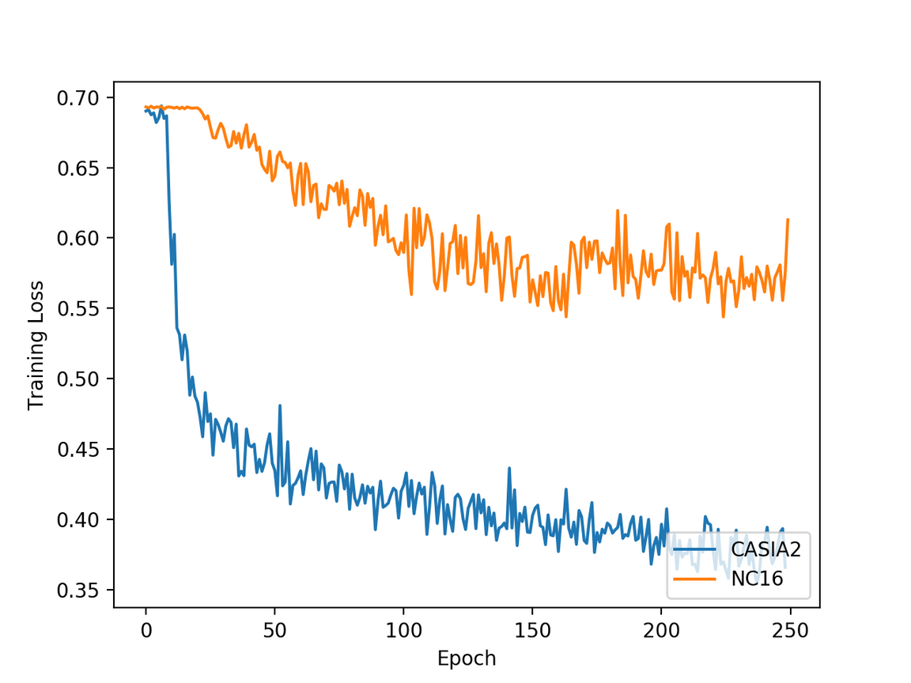
RESULT
DEMO LINK:

Slide 20
CONCLUSION

Slide 21
In this work we experimented with using a CNN in the image forgery detection task. More specifically, we used a CNN network to extract features from two datasets of varying difficulty, namely CASIA v2.0 and NC16. Furthermore, the extracted features were then used to train and test an SVM, achieving an accuracy of 96.82% and 84.89% on CA- SIA v2.0 and NC16 respectively. These results validate our intuition that the classification performance decreases the more challenging the samples are. What is more, our study has shown that image tampering can be detected with an accuracy of more than 84% even if done by professionals. However, according to our findings the implemented architecture does not easily generalize to datasets with different underlying distributions. To conclude, while there is surely a lot of work still to be done in the image forgery detection domain, we believe that neural networks will be able to detect tampered images regardless of their difficulty in the near future.

Slide 22
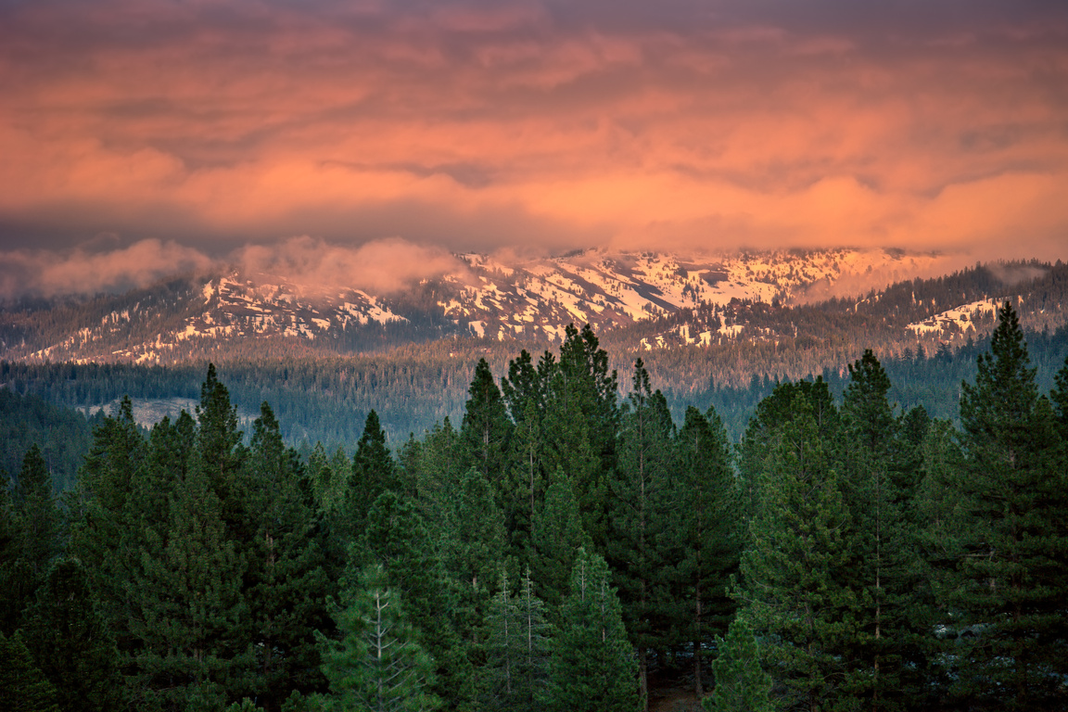
THANK YOU!
Total Score: 28 points

